Slide 1
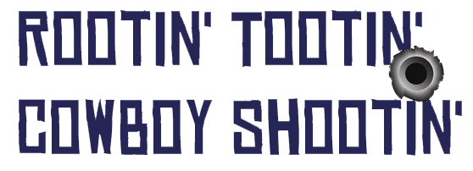
By Ryan Conway and Brian Doyle

Slide 2
The Game
First Person Shooter through the use of a myo armband
Shooting gallery style gameplay
Find and shoot all the targets

Slide 3
Myo Armband
The Myo armband lets you use the electrical activity in your muscles to wirelessly control your computer
These can be read through gestures
Connects to a USB through Bluetooth

Slide 4
Planning / Development
Wanted to make something in unity with Myo armband
Had a few ideas – Golf, Monkeyball type game, Shooter
Went with a shooter

Slide 5
Planning / Development
Initially developed the game with keyboard and mouse controls
Converted to Myo when it was working and the band was available
Plan to add sound effects, more levels, and a scoring system

Slide 6
Main Mechanics
Armbands motion controls camera movement
Deadzone helps with maintaining accuracy when aiming
Raycast detects when a target is hit

Slide 7

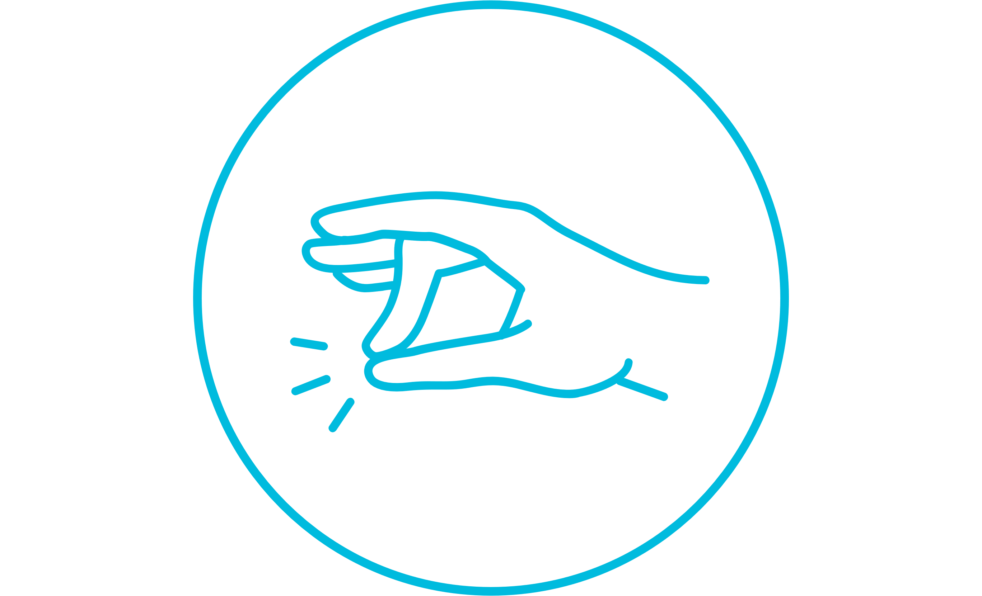


Gestures
Arm movement controls camera
Fist gesture to shoot (like squeezing a trigger)
Double tap to recalibrate aiming
Wave in and out to open and close pause menu (sliding it in and out of scene)
During gameplay
Double tap to recalibrate
Wave in and out to pause
Fist to shoot

Slide 8
Gestures
During menus
Arm movement deactivated
Each gesture mapped to a button on screen (Spread fingers to view controls, Wave in to play, etc.)

Slide 9
Taking Myo Input
Take in eularAngles from myo.localRotation
Check if the angle has passed the deadzone boundary in 4 directions
If it has, apply a rotation speed to the camera in that direction
Also check for gestures and apply appropriate actions

Slide 10
Demonstration

Slide 11
Any Questions?

